Slide 1
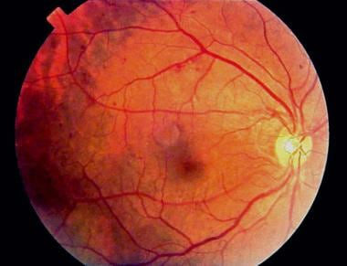
Deep Learning Based Technique For Multiclass Classification Of Diabetic Retinopathy Disease Grading
Presented by- Prerana Bora

Slide 2
Table of Contents
Introduction
Problem Definition
Motivation of problem
Objectives of the project work
Relevance to AI and ML
Literature Review

Slide 3
Analysis of design requirements relevant to the problem identified
Methodology to solve the Problem
Design & Implementation of the Project Work
Performance analysis of the proposed work
Scope & Limitations
Future Directions
Conclusion
Reference

Slide 4
Introduction
Diabetic retinopathy is a condition that occurs as a result of damage to the
blood vessels of the retina in people who have diabetes.
These blood vessels expand and cause venous bleeding. Or they can close, stopping blood from passing through.
Total of 2.6% blindness in adults worldwide are caused by diabetic retinopathy. 1/3rd of the diabetic patients have DR but shows no symptoms, leading to left untreated.
It is estimated currently in India about 3 million people aged 40 years or older live with VTDR and are at risk of vision loss.

Slide 5
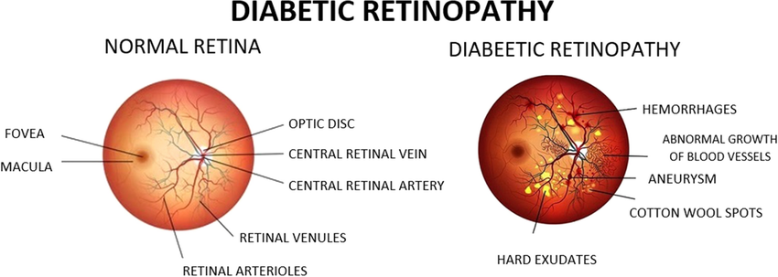

Slide 6
Problem Definition:
To help ophthalmologist, we can use computer technology to analyze eye images and classify the severity of the disease into five grades, from no disease to severe.
Detailed pictures of the eye fundus images, are taken using fundus cameras or retinal cameras.
Fundus images are then enhanced to improve their quality using computer vision techniques.
Then we use advanced computer programs called deep learning models. These programs learn to recognize patterns in the eye images, by mimicking the human brain's way of recognizing patterns.
The model learns hidden patterns from a large set of pre-labeled fundus images (Training). Those patterns include blood spots, swelling, and abnormal blood vessel growth.

Slide 7
The model is designed to classify the severity of diabetic retinopathy into five grades:
No DR (Grade 0): No signs of diabetic retinopathy.
Mild DR (Grade 1): Minor abnormalities, no significant damage.
Moderate DR (Grade 2): Noticeable damage, not severe.
Severe DR (Grade 3): Significant damage, risk of vision loss.
Proliferative DR (Grade 4): Advanced stage, serious risk of blindness.
Once trained, the model can analyze new fundus images and predict the grade of diabetic retinopathy.

Slide 8
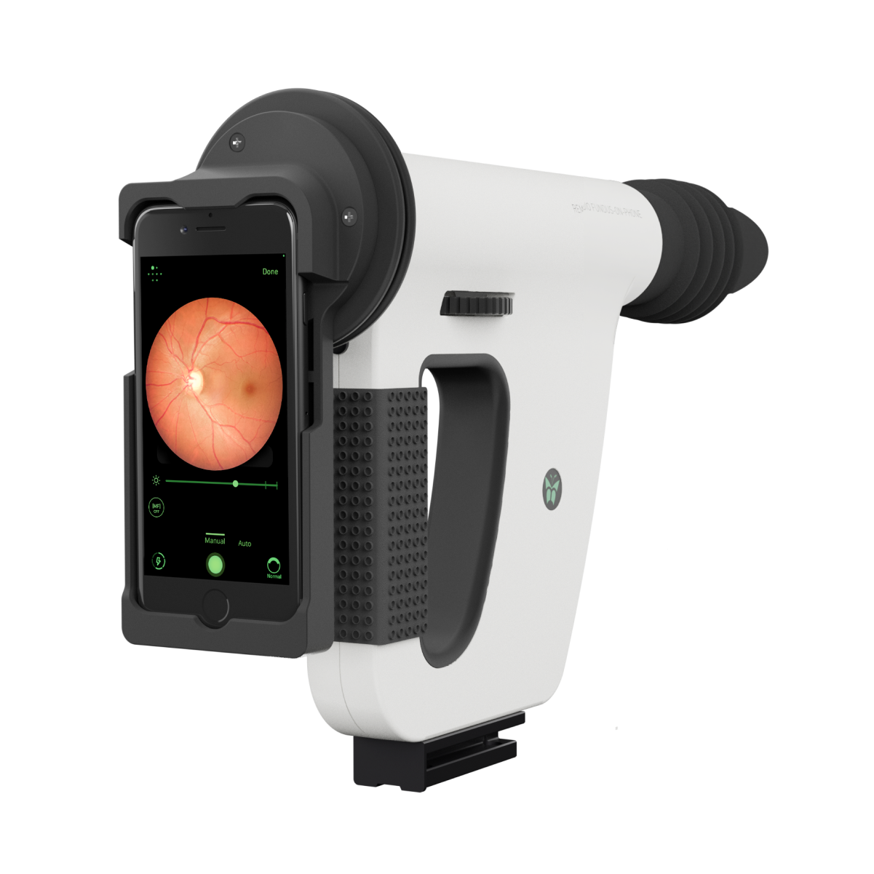
Fundus images are enhanced by applying Computer vision technology
Advanced computer program learns the hidden pattern from the fundus images
Classification
No DR (Grade 0)
Mild DR (Grade 1)
Moderate DR (Grade 2)
Severe DR (Grade 3)
Proliferative DR (Grade 4)

Slide 9
Motivation
To help ophthalmologist in early and fast diagnosis of Diabetic retinopathy.
The ratio of 928:1 between the 18.55 million diabetic retinopathy patients and the 20,000 ophthalmologists in India underscores the urgent necessity for technological interventions to detect diabetes Retinopathy within the mass population.(source:International Diabetes Federation (IDF) Diabetes Atlas (10th edition, 2021))
Manual classification of the 5 grades of diabetic retinopathy is challenging due to subtle differences in retinal features. Manual Grading can be subjective and prone to vary among different ophthalmologists, leading to inconsistent diagnoses.
Deep learning models, can automate the classification process, ensuring consistent and objective analysis.

Slide 10
Objectives Of the project is :
Develop a deep learning model capable of accurately classifying the five grades of diabetic retinopathy.
To reduce the time in diagnosis so that doctors can check large numbers of people's eyes quickly, and only focus on those who need help the most.
Use this program in remote places where there aren’t many eye doctors , so everyone can get checked for diabetic eye problems.
Make this DR detection affordable for everyone .
Ensure that the program provides a consistent result , reducing errors and uncertainty in diagnosis.
Help doctors in decision making with better interpretation , leading to improved treatment.

Slide 11
The objectives are to address the following challenges in DR detection:
Tackling the lack of widespread screening programs.
Addressing the shortage of skilled ophthalmologists.
Managing variability in image quality and interpretation.
Developing scalable and accurate automated screening solutions.

Slide 12
Relevance to the AI and ML

Slide 13
Recent Trend in diagnosis of diabetic retinopathy : Using Automated screening models using deep learning system.
Various techniques of AI and ML is used in DR grading :
Deep Learning Models:
Convolutional Neural Networks (CNNs) are used for image classification tasks in DR grading.
Techniques like InceptionV3, ResNet, and U-Net used to extract features from retinal images and classify them.
Support Vector Machines (SVM):
SVM is used as a supervised learning algorithm for classification tasks in diabetic retinopathy.
Clustering Algorithms:
K-means clustering used for unsupervised grouping of retinal images based on similarities in features.
Ensemble Methods:
Random Forests or Gradient Boosting Machines models can combine multiple classifiers to improve classification performance.
Transfer Learning:
It enable the use of pre-trained deep learning models, fine-tuned on large datasets, for diabetic retinopathy classification tasks.

Slide 14
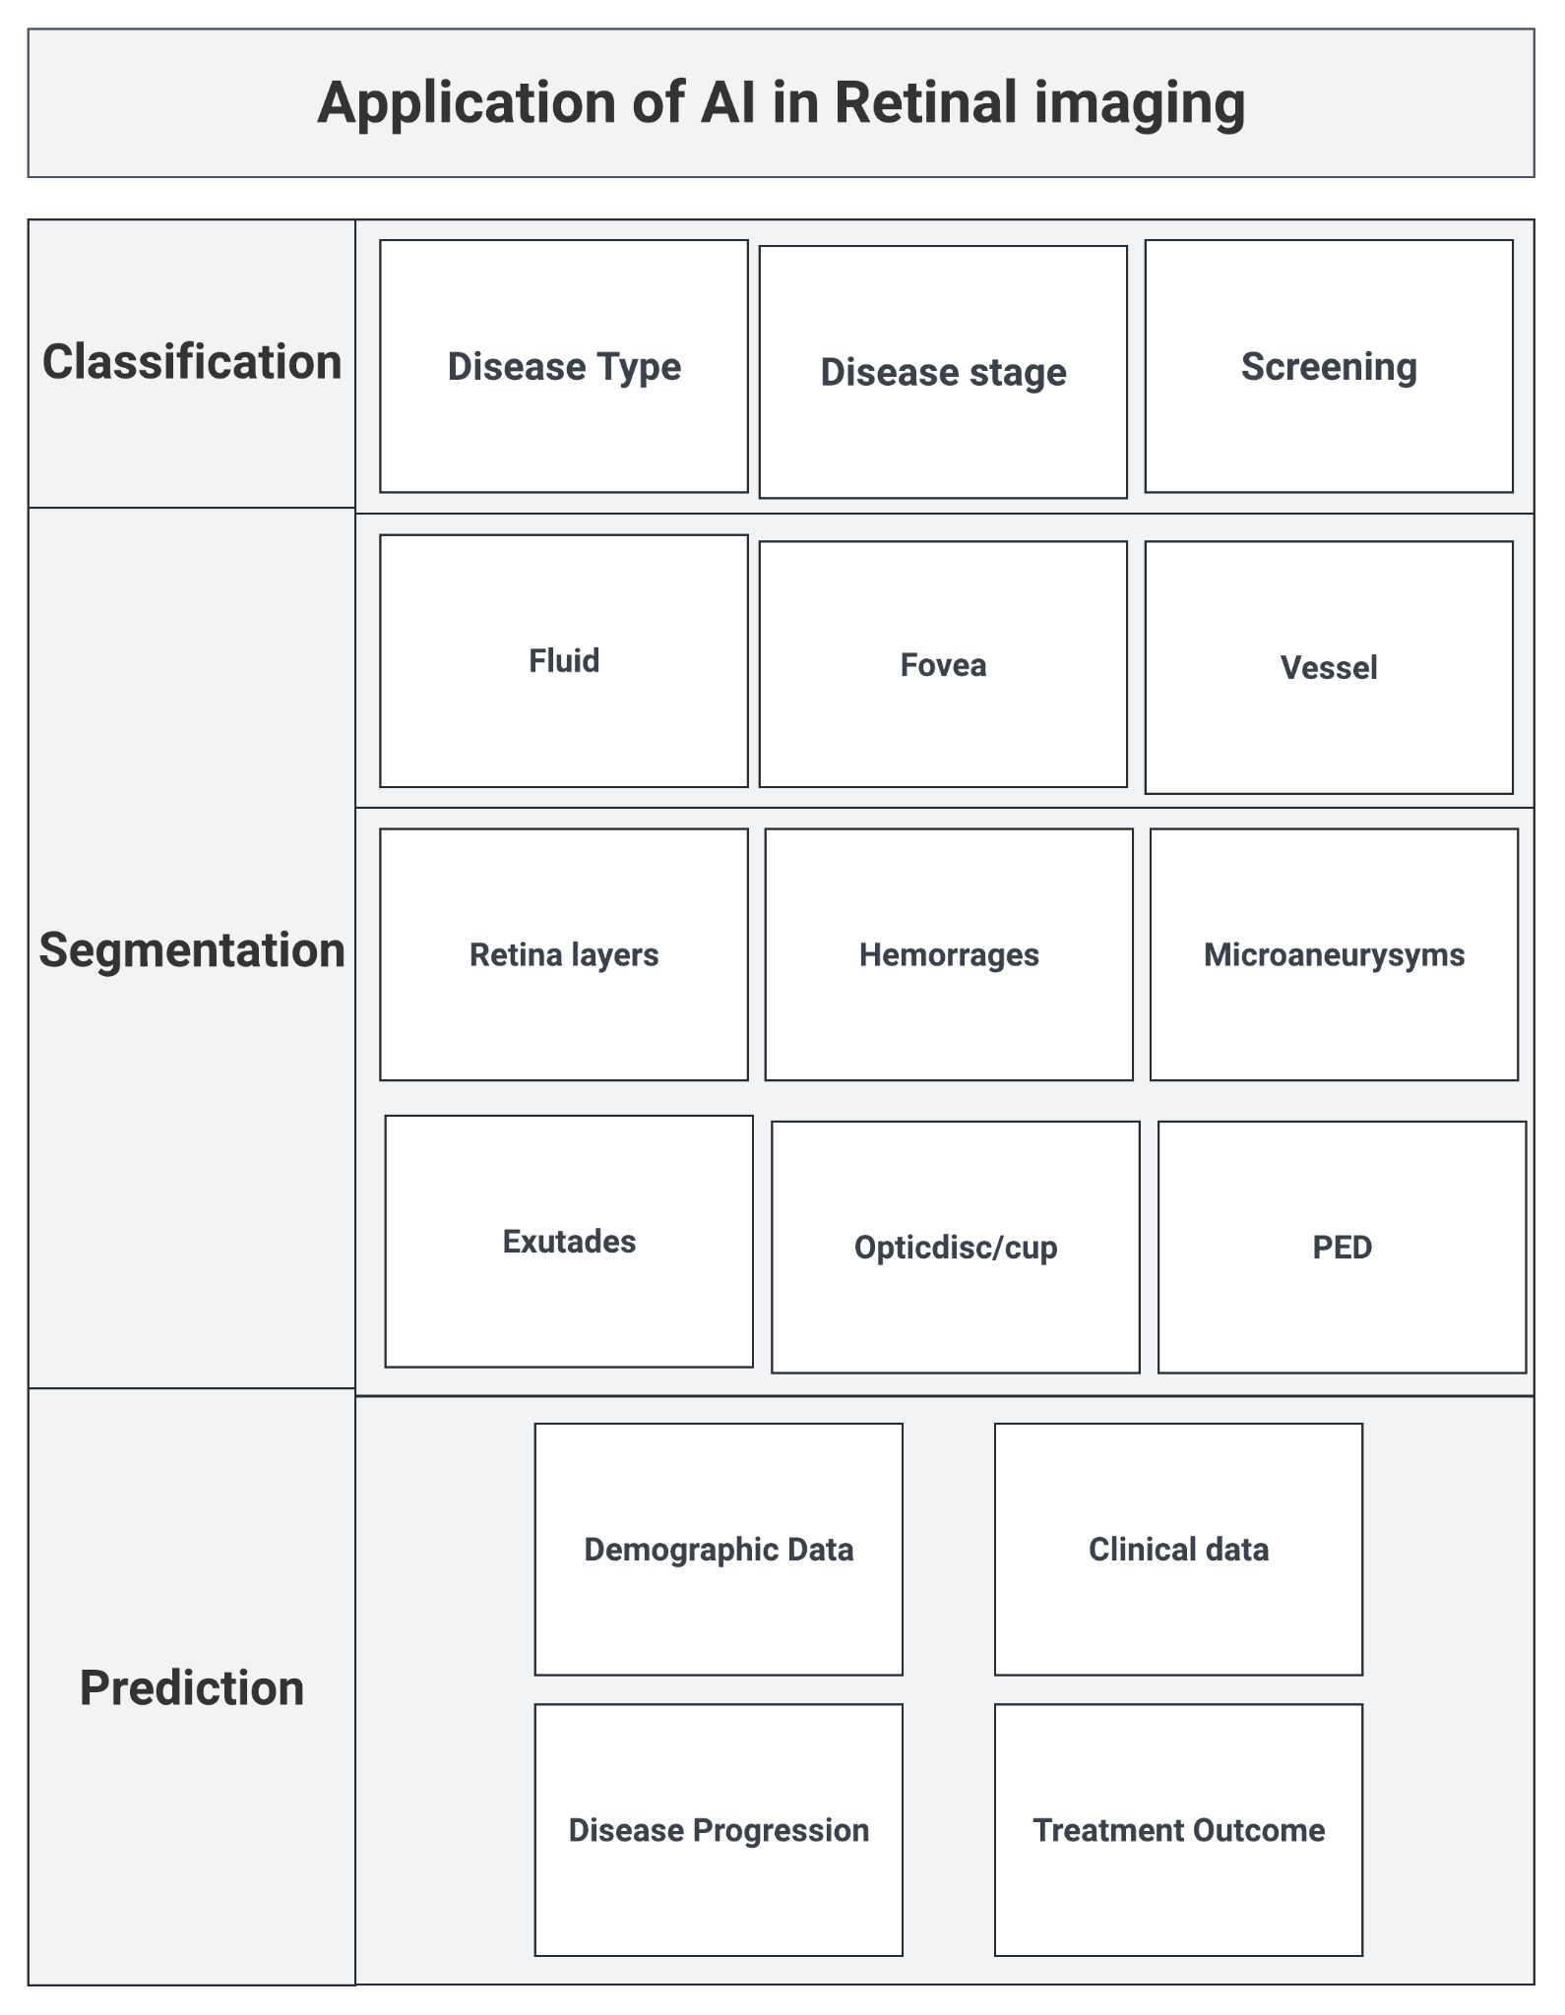

Slide 15
Existing work and Performance
(Literature Survey)

Slide 16
Diabetic Retinopathy Detection Using Prognosis of Microaneurysm and Early Diagnosis System for Non-Proliferative Diabetic Retinopathy Based on Deep Learning Algorithms(2020)
Lifeng Qiao; Ying Zhu; Hui Zhou
1
Methodology used:
PMNDPR(Prognosis of Microaneurysm and Early Diagnosis System for Non-Proliferative Diabetic Retinopathy) system is used. This system analyzes retinal images and identify early signs of diabetic retinopathy, such as microaneurysms and do early detection.
Here they utilized DCNN architecture for semantic segmentation of fundus images.
The system takes input images and features extracted by convolutional layers. The output of the convolutional layers is then flattened and analyzed by a fully connected layer with Relu activation, producing a 336-dimensional feature vector. Finally, a softmax function translates the output of the fully connected layer into the likelihood of each class.
For Preprocessing Curvelet Transform is used to enhance the dark lesions.
Optimal bandpass filtering is used to optimise the contrast of bright lesions.
Candidate lesions are then detected through a series of steps, including Gaussian filtering, matched filters, Laplacians, and maximizing mutual information.
Finally, candidate extraction involves measuring correlation coefficients of each pixel using non-linear filters with Gaussian kernels, then principal component analysis to reduce dimensionality and identify relevant features.

Slide 17
Quality of this work:
On average sensitivity values of 97.4%, 98.4% and 95.1%, respectively for detecting dark lesions
and 96.8%, 97.1% and 95.3% for detecting bright lesions.
Pros:
High sensitivity.
Efficient Preprocessing technique is used : PCA, curvelet transformation, bandpass filtering.
Flexible candidate lesion detection.
Classification accuracy increased than Gaussian mixture model and SVM.
Drawbacks:
Dependent on the trained image quality.( Aptos dataset is used here)
Shows false positive and false negative testing.
Complex model approach.
High time duration for training.

Slide 18
A Deep Learning Ensemble Approach for Diabetic Retinopathy Detection (2019)
SEHRISH QUMMAR1 , FIAZ GUL KHAN 1 , SAJID SHAH 1 , AHMAD KHAN1 , SHAHABODDIN SHAMSHIRBAND 2,3, ZIA UR REHMAN1 , IFTIKHAR AHMED KHAN 1 , AND WAQAS JADOON 1
2
Methodology Used:
Here used an end to end deep ensemble network for detecting all stages of DR.
Ensemble model: Resnet50, Xception, VGGnet
Addressed the imbalance data challenged by combine Preprocessing technique: Upsampling and Downsampling
The categorical cross entropy Loss function is optimized by using Nesterov accelerated adaptive moment estimation (Nadam) optimizer.
This study prefers SGD over Adam optimizer in DR grading.

Slide 19
Quality of this work:
Accuracy: on average 80.8%
Recall (Sensitivity) : For class 0 (Normal) highest recall due to a large number of negative examples. For class 1 (mild) lowest recall due to subtle features.
Precision: 0.63
F1 score:0. 53
Pros:
The ensemble approach enhances classification accuracy.
By combining multiple models through stacking, the ensemble method offers increased robustness and generalization capabilities.
Drawbacks:
The model may still exhibit shortcomings in accurately detecting all stages of DR.
The imbalance in the distribution of samples may contribute to biases in model performance, affecting the overall recall and precision rates.
The F1-score, representing the harmonic mean of precision and recall, is relatively low at 53.74%, suggesting a trade-off between precision and recall that may impact the model's overall effectiveness in diabetic retinopathy severity classification.

Slide 20
Automatic Detection and Monitoring of Diabetic Retinopathy Using Efficient Convolutional Neural Networks and Contrast Limited Adaptive Histogram Equalization (2020)
ASRA MOMENI POUR1 , HADI SEYEDARABI 1,2, SEYED HASSAN ABBASI JAHROMI3 , AND ALIREZA JAVADZADEH4
3
Methodology used:
Utilized the Contrast Limited Adaptive Histogram Equalization (CLAHE) method to enhance image quality and normalize intensities as a pre-processing step
Employed the EfficientNet B5 architecture for classification, known for its efficiency in scaling network dimensions uniformly.
The hyperparameters of the EfficientNet architecture are tuned :depth, width, and resolution scaling are adjusted to find the optimal.
The selected EfficientNet model is trained on the preprocessed dataset .
Evaluate the model's performance by training on a mixture of Messidor-2 and Messidor datasets and testing on the IDRID dataset

Slide 21
Quality of this work:
Achieved 92% sensitivity and an AUC of 0.94
The proposed method is compared with state-of-the-art models, notably achieving an enhanced AUC from 0.936 to 0.945 on the Messidor dataset.
Pros:
Implementing CLAHE as a pre-processing step ensures that the input images are appropriately enhanced and standardized before feeding them into the DR monitoring model
Efficient Nets are introduced as a state-of-the-art CNN model known for reducing parameters and operations while improving accuracy and speed.
Using CLAHE overcomes limitations of other methods like Histogram Equalization (HE) and Adaptive Histogram Equalization (AHE).
The obtained results confirm the efficiency of the suggested method without the need for data augmentation.
Drawbacks:
Reliance on Messidor-2 and IDRID datasets may restrict the model's ability to generalize to diverse retinal images.
Dependence on pre-trained EfficientNet models might not fully adapt to the nuances of retinal image features, potentially limiting performance.
Manual tuning of scaling parameters for Efficient Nets, like Efficient Net-B5, poses challenges and may increase computational demands, hindering practical deployment.
Need heavy hardware supports like need NVIDIA 1080ti GPU supports.
Transformer based model shows better accuracy than this approach.

Slide 22
End-to-End Adversarial Retinal Image Synthesis (2018)
Pedro Costa; Adrian Galdran; Maria Ines Meyer; Meindert Niemeijer; Michael Abràmoff; Ana Maria Mendonça; Aurélio Campilho
4
Methodology Used:
Here proposed an adversarial autoencoder for retinal vessel network synthesis, followed by generation of color retinal images using a generative adversarial network.
Utilized Messidor-1 and DRIVE datasets for training.
Employed encoder-decoder architecture with U-Net for vessel segmentation.
Evaluated through subjective visual assessment and quantitative ISC metric analysis.
Found synthetic images to exhibit global consistency, but slightly lower performance in vessel segmentation compared to real images. Future work aims to enhance realism and expand applicability to other medical imaging tasks.

Slide 23
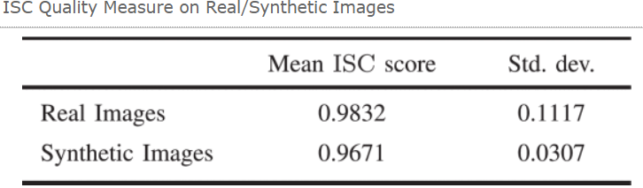
Quality of this work:
Pros:
The adversarial learning framework allows us to model the underlying distribution of plausible retinal images only from training data, without manually interacting with parameters, controlling complex mathematical e models of the retinal anatomy.
Once trained, the model improves upon by allowing to generate any amount of realistic retinal images, with associated vessel trees, in an efficient manner.
Unlike previous approach, this generate separate parts of the retinal anatomy through the same process, avoiding the combination of complex image processing tasks.
Drawbacks:
Trained on a small dataset (614 images) from Messidor-1 database, restricting variability.
Synthetic images generated at 256 × 256 resolution, lower than real images.
Synthetic vessel networks lack realism, displaying interruptions and inconsistent width variations.
Challenges stem from data and computational resource limitations.
Future Directions: Incorporate clinical labels into larger datasets for improved realism and applicability.

Slide 24
5
Data Augmentation for Improving Proliferative Diabetic Retinopathy Detection in Eye Fundus Images
(2020)
Teresa Araújo; Guilherme Aresta; Luís Mendonça; Susana Penas; Carolina Maia; Ângela Carneiro; Ana Maria Mendonça Aurélio Campilho
Methodology used:
Data augmentation approach by synthesizing synthetic neovascularizations within eye fundus images to simulate grade 4 diabetic retinopathy cases, thereby enhancing the training dataset for DRGraduate
DRGraduate: a deep learning-based grading system, to improve detection accuracy, especially in severe proliferative diabetic retinopathy cases.
Quality of work:
High detection accuracy. Increased from 71% to 74%.
Better performance in identifying R4-labeled images.
Synthetic NVs closely resemble true NVs, enhancing dataset realism.
Data integrity is preserved by augmenting R0-R3 images while maintaining original R4 images.

Slide 25
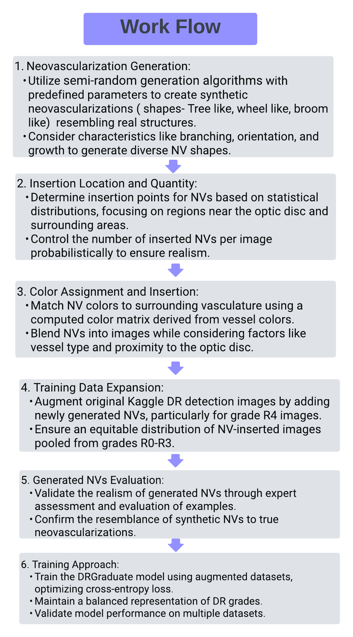
Drawbacks:
Misclassification of other structures as neovascularizations, leading to false positives.
Difficulty in distinguishing between neovascularizations and other lesions like IRMAS, especially in early stages.
Some neovascularizations with unusual shapes or sizes, may be missed by the mode.
Unrealistic color attribution to neovascularizations due to the presence of light artifacts, resulting in color aberrations.

Slide 26
Deep Learning Techniques for Diabetic Retinopathy Classification: A Survey (2022)
Mohammad Z. Atwany; Abdulwahab H. Sahyoun; Mohammad Yaqub
6
Supervised method: Binary classification:
Quellec et al. used 3 layer CNN architecture with pretrained AlexNet and two networks of Team o_O solutions for the Kaggle challenge .
Database: Kaggle DIARETDB1 and private E-ophtha
size: (448, 448)
Preprocessing: crops, pixel normalization, gaussian filter.
Feature extracted: Microaneurysms, hemorrhages, soft and hard exclusion.
Xu et al. used stochastic gradient descent as optimizer.
Dataset: Kaggle eyepacs.
Augmentation: rotation, rescaling, flipping, shearing, translation.
Eight 2D conv layer, max pool, fully connected layer softmax.
Extracted features: Hard exudates, red lesions, microaneurysms, blood vessels.
Jiang et al. Pre-trained CNNs Inception V3, Inception-ResNetV2, ResNet152, Adaboost algorithm for output integration, Adam optimizer.
Private dataset used with size 520X520 size
Aigmentation:Translation,Rotation,Mirroring,Brightness, contrast, and sharpness adjustments

Slide 27
Supervised method: Multiclass classification:
Study:
Architecture
Dataset
Preprocessing and augmentation
Extracted features
Referable diabetic macular edema, moderate or worse DR, severe or worse DR, fully gradable New fully connected layers on top of pre-trained CNNs, strong model integration Stages of Diabetic Retinopathy Features from ResNet50 used as inputs for attention modules Features from green component and gray levels entropy images enhanced with unsharp masking
Abràmoff et al.
10 CNNs based on pre-trained InceptionV3
Private dataset
Normalization, resizing to 299 pixels diameter
ResNet50, InceptionV3, InceptionResNetV2, Xception, DenseNets
13,767 images from an unspecified dataset
Cropping, resizing, histogram equalization, adaptive histogram equalization ,Image enlargement, contrast improvement through contrast stretching for dark images
Zhang et al.
Li et al.
Pao et al.
ResNet50 with four attention modules
Messidor dataset and IDRiD dataset
Augmentation, normalization, resizing
Bi-channel CNN with 4 convolutional layers per channel
Kaggle Diabetic Retinopathy dataset (21,123 RGB fundus images)
Resizing to 100x100x3 pixels, flipping, rotation, unsharp masking for gray-level high-frequency parts and green component

Slide 28
Self supervised: Binary classification
Study:
Architecture
Dataset
Preprocessing and augmentation
Extracted features
Feature learning module using ResNet50, fuzzy clustering module for self-supervision, reconstruction module with deconvolutional layers.
Luo et al.
Self-Supervised Fuzzy Clustering Network (SFCN)
Private dataset (unspecified)
Images resized to (224, 224, 3)
He et al.
Lin et al.
Self supervised: Multiclass classification
CABNet (Category Attention Block Network)
Messidor, EyePACS, DDR
Images resized to (512, 512, 3),
Random horizontal flips, vertical flips, rotation
Feature maps from backbone CNN, Global Attention Block (GAB), Category Attention Block (CAB)
MCG-Net (Graph Convolutional Network with SSL)
Feature extraction with GCN for classification, SSL for generalization, class correlation capture through CGCN
ODIR, SSL, GTest

Slide 29
Transformer based method:
Study:
Architecture
Dataset
Preprocessing and augmentation
Extracted features
Images split into patches (16,16), projected to embeddings with positional markers
Referable diabetic macular edema, moderate or worse DR, severe or worse DR, fully gradable
Pixel relation-based encoder, lesion filter-based decoder
Dosovits L. et al.
Vision Transformer (ViT)
Various (unspecified)
Lesion-aware Transformer (LAT)
Messidor-1, Messidor-2, EyePACS
Images resized to (512,512), vertical flips, horizontal flips, random cropping, color jitter Vertical flips, horizontal flips, random cropping, color jitter
Sun et al.
Kamran et al.
Papadopoulos et al.
Conditional GAN (ViT-based)
Private dataset
Images of size (576,720), crop size overlapping of (512,512)
Generator with residual, spatial feature fusion, upsampling, downsampling; Transformer encoder blocks for discriminators
Transformer-based method for local information extraction
Kaggle EyePACS, Messidor-2, IDRiD
Resizing to 100x100x3 pixels, flipping, rotation, unsharp masking for gray-level high-frequency parts and green component
Attention mechanism to generate heatmaps, focuses on eye regions with lesions

Slide 30
Results: Supervised techniques
Study:
Architecture
Accuracy
F1 Score
0.81
0.86
Kappa
98.1%
38.77%
Comment
Pao et al.
Entropy-based Model
Generates entropies to highlight lesion edges
87.37%
Ensemble of pre-trained networks
High accuracy, sensitivity, and specificity
Zhang et al.
Luo et al.
Lin et al.
Li et al.
96.5%
81.7%
92.6%
Uses self-supervised fuzzy clustering
SFCN
GCN for classification, SSL for generalization
Single ResNet50
Simpler architecture with competitive performance

Slide 31
Results: Transformer
Study:
Architecture
Accuracy
F1 Score
0.94
Kappa
95.7%
38.77%
Comment
Kamran et al.
VT-GAN
30% better FID and KID scores than SoTA (A2GAN, StarGAN-v2)
78%
MIL Attention Mechanism
High-quality attention maps for lesions
MIL-based
MIL-VT
LAT
85.5%
96.3%
Aggregates
patches based on features and attention
MIL-VT
Lesion Aware Transformer (LAT)
Uses attention blocks for lesion importance learning

Slide 32
Gaps Identified in Existing Research Work
Existing methods shows inefficiency dealing with imbalanced data
Computationally expensive.
Bias exists for Mild DR cases.
Poor performance for Proliferative DR detection.
Challenges face in model Interpretability.
Accuracy was not meeting expectation.

Slide 33
Proposed Approach

Slide 34
Analysis of design requirements
DFD 0
Impact of different Preprocessing Techniques
Ensemble Model
Classify
5 classes of DR
image
Retinal images

Slide 35
2. DFD 1
CLAHE
Processed image
Base
Models
Meta Model
Classified
Image
BEN GRAHAM
Processed image
Retinal images
GREEN CHANNEL CLAHE WITH BEN GRAHAM
Processed
image

Slide 36
3.DFD.2: CLAHE
Split to L, A & B
Histogram Equalisation
Pre Processed
image
Change to LAB space
image
RGB
Retinal images
LAB

Slide 37
4. DFD.3: Ben Graham:
Subtract local average color
Scale Radius
Apply Circular Mask
Preprocessed image
image
Resize
Retinal images

Slide 38
5. DFD.4: Modified Approach
Preprocessed image
Image
Apply CLAHE on Green Channel
Clip image to 90%
Ben graham
Gaussian blur
Retinal image

Slide 39
Input
Pandas
Numpy
opencv
Preprocessing
Files
DataFrame
Image
Datagenerator
Train
Generator
Validation generator
Interpretation
sklearn
Seaborn
Optuna
TensorFlow Keras
matplotlib
Hyperparameter tuning

Slide 40
Hardware used:
Local system:
Ram : 8 GB
GPU : NVIDIA GeForce GTX 1650

Slide 41
Software used:
Operating System Type: Microsoft Windows 10
Purpose: Compatible with deep learning framework
Python Version : 3.12.2
Deep Learning Framework:
Framework: TensorFlow and keras
Purpose: Implementing and Training Ensemble Learning Model
Key Libraries: Tensorflow
Keras (Model Implementation)
Opencv-python (image preprocessing)
Numpy, pudus (data manipulation)
Optuna (Hyperparameters tuning)
Matplotlib, Seaborn, sklearn

Slide 42
Development Environment:
Tools : VS Code Purpose: Writing , debugging and experimenting with code
Environment Identification Development:
Python Version: 3.12.2
Virtual Environment: Created and managed using venv.
Package Management: pip

Slide 43
Methodology:
Data Collection and Preprocessing
Dataset: EyePACS Diabetic Retinopathy dataset ( a subsample is taken)
Data Balancing: Combination of random undersampling and random oversampling
Image Preprocessing:
Normal Preprocessing: Standard resizing and normalization
Ben Graham Preprocessing: scaling to a specified radius, subtracting local average color, clipping it to remove boundary effects, and resizing it to a target size.
CLAHE Preprocessing: Contrast Limited Adaptive Histogram Equalization
Combined Preprocessing: Applying a modified technique of CLAHE on green channel, ben graham kernel sequentially

Slide 44
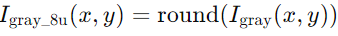
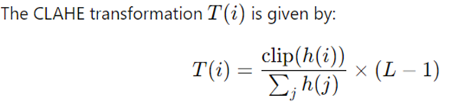
Preprocessing : 1st approach: CLAHE (Contrast Limited Adaptive Histogram Equalization):
Algorithm:
Input: RGB image
Convert RGB to Grayscale
Convert grayscale to 8-bit unsigned integer .
Create CLAHE object clahe with clip limit 2.0 and tile grid size (8, 8)
Apply CLAHE to 8-bit
Convert it to 16 bit
Convert 16 bit to float32
Convert Float 32 to RGB
Output: Return RGB image

Slide 45
Preprocessing Steps: | Mathematical formulation
Convert RGB to Grayscale
2. Convert grayscale to 8-bit unsigned integer
3. Create CLAHE object clahe with clip limit 2.0 and tile grid size (8, 8)
4. Apply CLAHE to 8-bit | ILAHE(x,y)=CLAHE(Igray_8u(x,y))
5. Convert to 16 bit
6. Convert 16 bit to float 32
7. Convert float 32 to RGB and resize

Slide 46
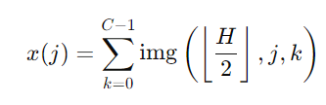
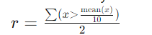
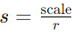
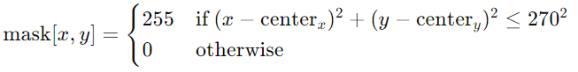
Preprocessing : 2nd approach: Ben Graham’s Preprocessing
Algorithm:
Calculate Horizontal Sum: Compute the sum of pixel values along the width at the vertical center.
Determine Radius:
Compute Scaling Factor:
Resize Image.
Apply Gaussian Blur (0, 0) and standard deviation 10
Add weights and subtract the local average color
Clip the image to 90% to remove boundary effects by applying circular mask centered at the image center with a radius of 270 pixels.
Resize image to (224, 224)

Slide 47
Preprocessing steps: | Mathematical formulation
Compute the sum of the pixel values among the width at the vertical center.
2. Compute the radius
3. Compute the scaling factor
4. Resize the image | resize(img, scaleX1/r)
5. Apply Gaussian blur | GaussianBlur(img,(0,0),10)
6. Add weights and subtract the local average
7. Clip the image
8. Resize the image | cv2.resize( clip_img, target_size)

Slide 48
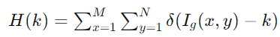
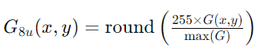
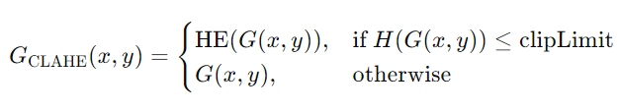
Preprocessing : 3rd approach: Modified approach
Algorithm:
Compute the histogram H(k) of the green channel image, where Hk represents pixel intensities ranging from 0 to 255.
2. Convert Green Channel to 8-bit Unsigned Integer
3. CLAHE Function CLAHE on Green Channel
Where M and N are dimension of the image, Ig(x,y) intensity of green channel

Slide 49
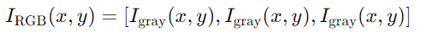
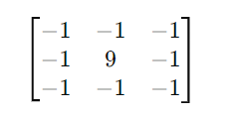
4.
5. Convert the CLAHE Output to float32
6. Convert Grayscale Back to RGB
7. Clip the image to 90% by applying circular mask.
8. Ben Graham’s Kernel Used :
9. Gaussian Blur : (3 3) kernel with std deviation 10
10. Return processed image.

Slide 50
Preprocessing steps | Mathematical formulation
Compute the histogram of the green channel image ranging from 0-255
2. Convert green channel to 8 bit unsigned integer
3. CLAHE function
4. CLAHE on the green channel
5. CLAHE apply on the image
6. Convert to float32
7. Convert Grayscale back to RGB
8. Ben graham’s kernel
9. Gaussian Blur | GaussianBlur(img,(3,3),10)

Slide 51
2. Data Augmentation:
Normalization: 1./255
Rotation range : 15 degree
Shear range : 0.1
Zoom range: 0.1
Horizontal flip
Vertical flip

Slide 52
Model Selection and Training:
Model Used:
InceptionV3
ResNet50
EfficientNet-B5
DenseNet169
Pretrained on ImageNet
Transfer learning : Fine tuning
Combined by Ensemble model.

Slide 53
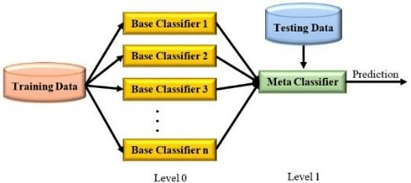
Ensemble technique used : Stacking Ensemble
Combine the prediction of several other learning algorithms.
All the above algorithms are trained using available data, then a combiner algorithm is trained to make a final prediction using all the prediction of the other algorithms as additional input.
First step- Train multiple base models, and merged their predicted results called Meta dataset
Second step- Using meta dataset to build meta learner and do final prediction.

Slide 54
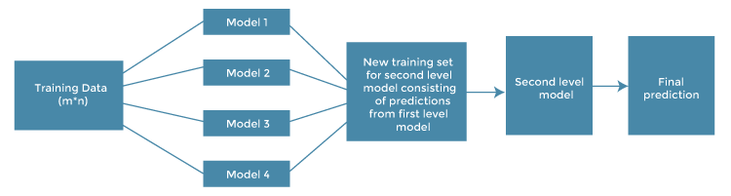
Model prototype:

Slide 55
Ensemble model workflow:
Base Model
Load Model
Remove the top layer .
Add additional Layer With Softmax with 5 Classes . This will personalize the inception model for the problem
Train it with the dataset
Ensembling
Load base models
Remove the top layer which previously added.
Second last layer output is taken. ( Array )
For 4 models we will get 4 latent features.
Concatenate those output.
It is then given to fully connected layer with new soft max layer
Train the added dense layer alone (freeze the training of the layers in base model )
prediction.

Slide 56
Base Model
Remove Top Layers
Add Dense Layer
Add Softmax with 5 classes
Base Model Workflow:
Train
Prediction

Slide 57
Load Base Model
Remove the top Layer
Take penultimate layers of each
4 arrays
Meta Model Workflow
Concatenation of features
Dense Layer
Softmax
Prediction
Train added dense layers

Slide 58
Transfer Learning Methodology used:
Inductive Transfer learning: All base models are pretrained.
The pre-trained model learns general features that are useful for a range of tasks. These Pretrained models are then fine tune for specific tasks.
Benefits:
Reduced training time and computational resource
Improve model performance

Slide 59
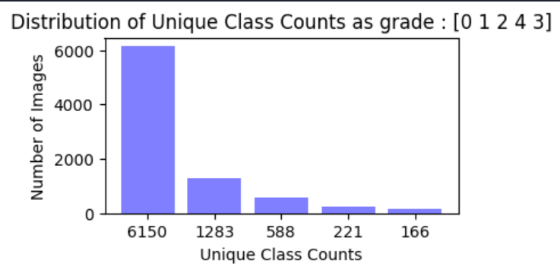
Design and Implementation of Project work
Dataset: 8.39 GB
Image size: Varying size( example: 3168 X 4752 X 2 )
Eyepac dataset
Imbalance
5 classes are there.

Slide 60
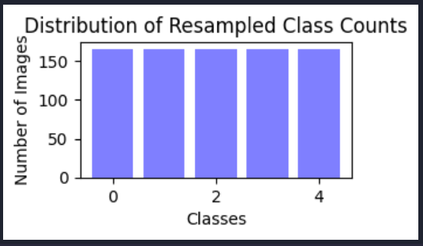
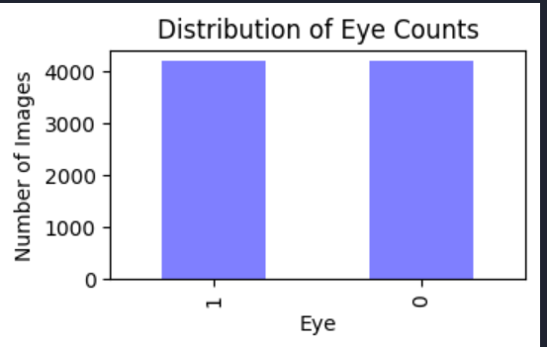
After Balancing the dataset:
Each class have 166 images.
Made sure both eye have equal distribution.

Slide 61
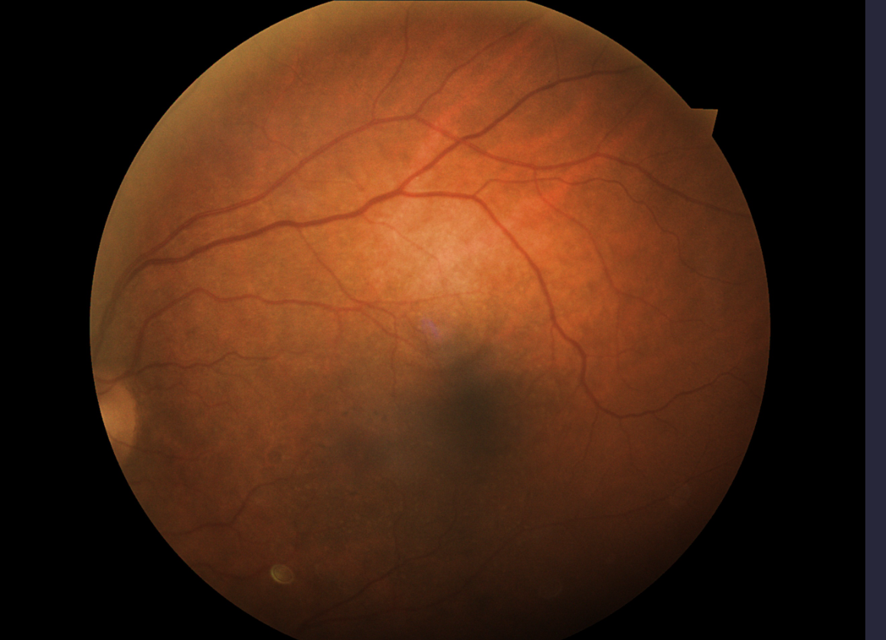
Original sample image:

Slide 62
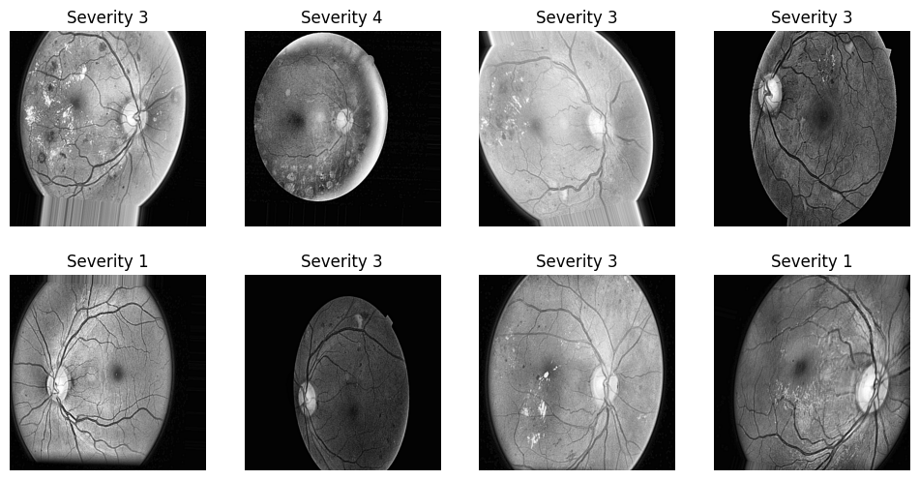
Preprocessing approach 1:

Slide 63
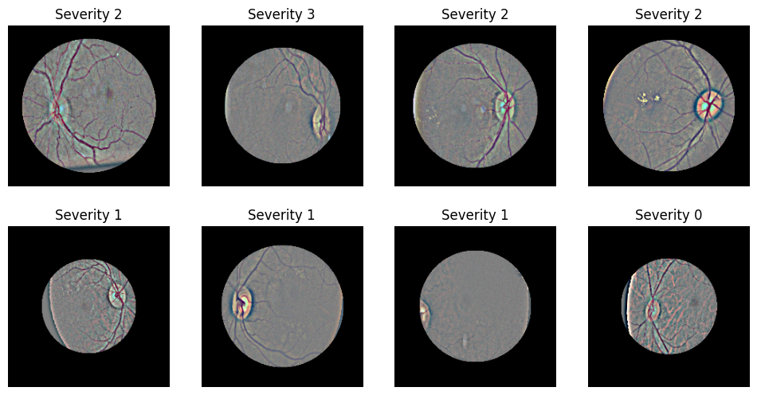
Preprocessing approach 2:

Slide 64
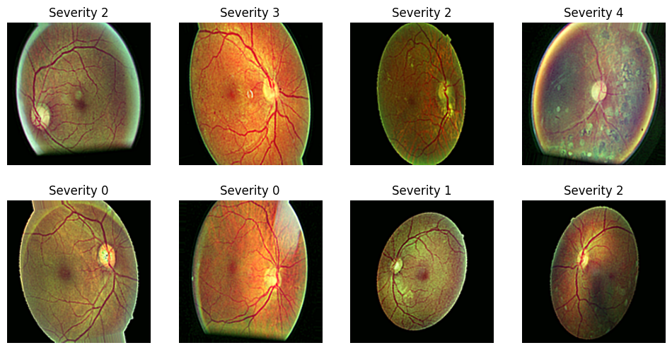
Preprocessing approach 3:

Slide 65
Train/
Test
split
Sample
dataset
Balancing
Pre-processing
Augmentation
BM-1
BM-2
BM-4
BM-4
Base model training
Meta Model training
Meta Model
construction
Classification

Slide 66
Image Preprocessing
Deep Ensemble model
Training
ResNet50
InceptionV3
EfficientNet B5
DenseNet169
Retinal input image set
Validation
Data Augmentation
Uniformly weightage
Softmax
Softmax
Softmax
Softmax
Evaluation
1. Accuracy 2.Confusion matrix
3. ROC curve
No DR
Mild DR
Moderate DR
Severe DR
Proliferative DR
Combined feature concatenation
Classified output
Ensemble model

Slide 67
Base Model architecture
Load Pre trained model. Input : 224 X 224
Dense layer :
Batch size: 32, Learning Rate : 0.001, Optimizer: Adam, Loss function: categorical cross entropy
Epocs: 20 for InceptionV3 and ResNet50
10 for EfficientNet B5 and DenseNet169
Output: (None, 512)
Global average pooling 2D
Dense 1024 ( activation= ReLu, Regularization L2= 0.1
BatchNormalization
DropOut = 0.2
Dense 512 ( activation= ReLu, Regularization L2= 0.1
BatchNormalization
DropOut = 0.2
Softmax

Slide 68
Meta Model :
Load all 4 models.
Batch size: 6; Learning rate: 0.001; Optimizer: Adam
Epocs:60
Loss Function: categorical cross entropy
Concatenation layer
2 Dense Layer, L2 regularization 0.5, drop out 0.5
Multi Input Generator
Softmax
Training Data

Slide 69
Performance Analysis of the Ensemble Model with 3 approaches:
Approach
Precision
Recall
F1 score
Accuracy
!
1 Modified
approach
0.40
0.40
0.38
0.40
2 Clahe
0.48
0.42
0.43
0.42
3 Ben Graham
0.34
0.33
0.33
0.33

Slide 70
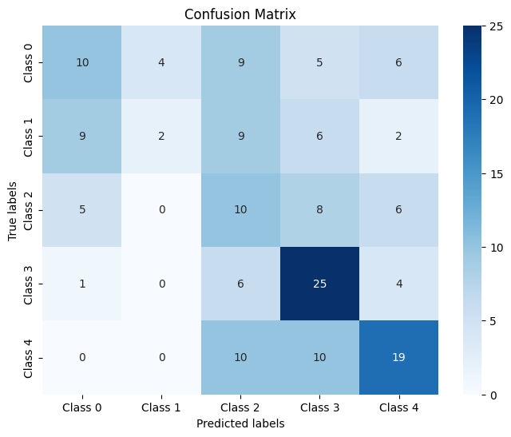
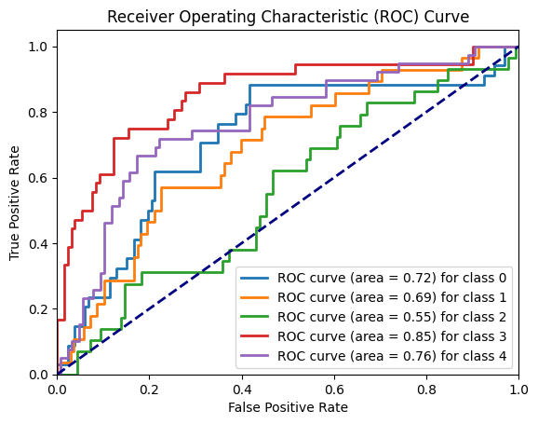
Modified Approach

Slide 71
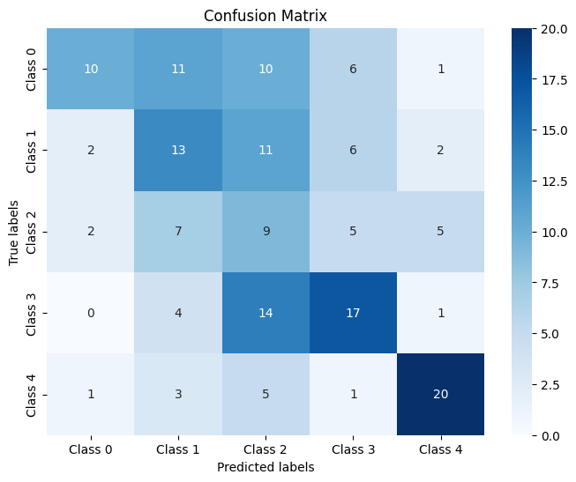
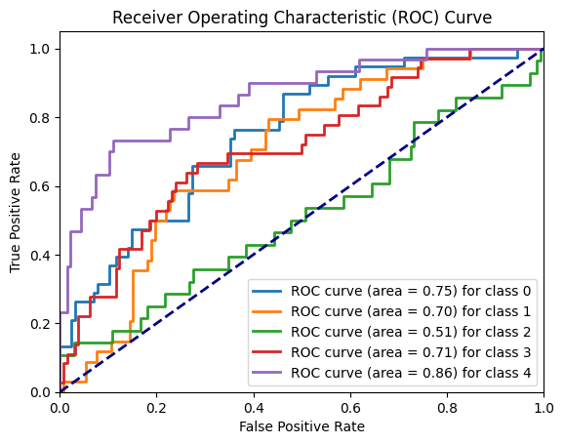
For Preprocessing Approach CLAHE

Slide 72
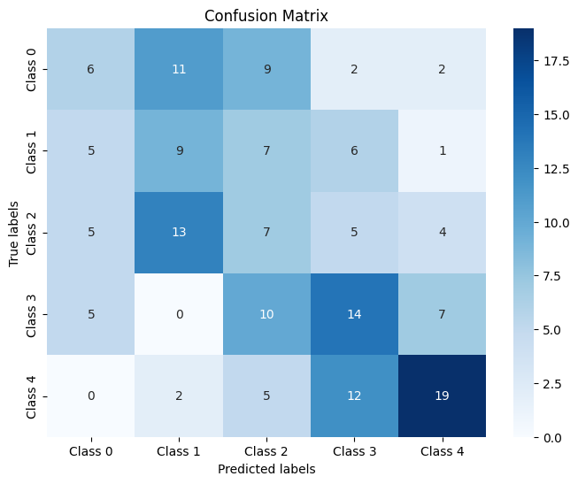
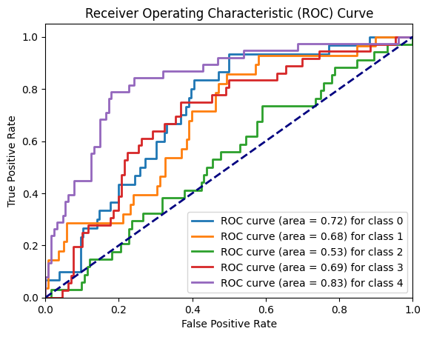
For Preprocessing Approach Ben Graham’s

Slide 73
Comparison:
Approach 1: Clahe : This approach works better in class 0 and class 1.
Works good for class 4 also but false negative rate is high.
Approach 2: Ben graham’s approach: This method shows moderate result for input (224 , 224) case.
Approach 3: Modified approach: Significantly works better for grade 2, grade 3 and for grade 4 the false detection also spread within severe range.

Slide 74
Scope of Ensemble model:
1. Combining multiple models can lead to more accurate and reliable predictions, have potential to implementation in clinical settings.
2. Ensemble models can integrate various perspectives, enabling a comprehensive understanding of the relationships between different regions of medical images.
3. By aggregating the strengths of individual models, ensemble methods can provide more stable and robust predictions, reducing the likelihood of errors in diagnosis.
4. By implementing transfer learning the we can modify the already proven effective pre trained for our own task resulting development of effective models even with limited medical data.

Slide 75
Limitations of Ensemble model:
1.Ensemble models often require a large amount of data to train effectively, which can be a limitation in the medical field where labeled data is scarce.
2. Training and inference with ensemble models can be computationally expensive, requiring significant hardware resources.
3. Ensemble models might struggle with localizing specific features in medical images, which is crucial for precise diagnosis.
4. Transformer architecture performs significantly better result.

Slide 76
Future Direction:
Working with image size (512,512) for better accuracy generalisation.
Implementing Generative adversarial network for data augmentation
Enhanced Computational Efficiency:
Model Compression: Techniques like model pruning, quantization can be used to reduce the computational requirements of ensemble models.
Distributed Computing: Utilizing distributed computing frameworks to parallelize the training process can help manage computational demands.
4.Fine-Grained Localization
Attention Mechanisms: Incorporating attention mechanisms into ensemble models can improve the ability to localize specific features in medical images.
Multi-Scale Analysis: Implementing multi-scale analysis techniques can enhance the model’s ability to capture both global and local features.
5. Attention map for better interpretation.

Slide 77
Conclusion:
1.This research project introduced an innovative ensemble learning approach for diabetic retinopathy (DR) screening, leveraging multiple machine learning models to enhance accuracy and reliability in disease classification.
2.Through the utilization of deep learning techniques, particularly convolutional neural networks (CNNs), implementing computer vision to automate the detection process. This will reduces the reliance on highly trained experts and helps to efficient management of diabetic retinopathy cases.
3.Future Directions includes to further refine and optimize the proposed techniques, particularly in handling class imbalances and improving the efficiency of detecting proliferative data collection.

Slide 78
References:
1.https://ieeexplore.ieee.org/document/9091167
2..https://ieeexplore.ieee.org/stamp/stamp.jsp?arnumber=8869883
3. https://ieeexplore.ieee.org/stamp/stamp.jsp?arnumber=9125868
4. https://ieeexplore.ieee.org/document/8055572
5. https://ieeexplore.ieee.org/document/9214404
6.https://ieeexplore.ieee.org/document/9729867

Slide 79
Thank-you

Slide 80
Ensemble model training with ben graham’s preprocessing
Total Data: 35126
After balancing: 3540
Each class:708
Image size=(512,512)
Batch size=32
Number of training set= 2832
Number of validation set=708

Slide 81
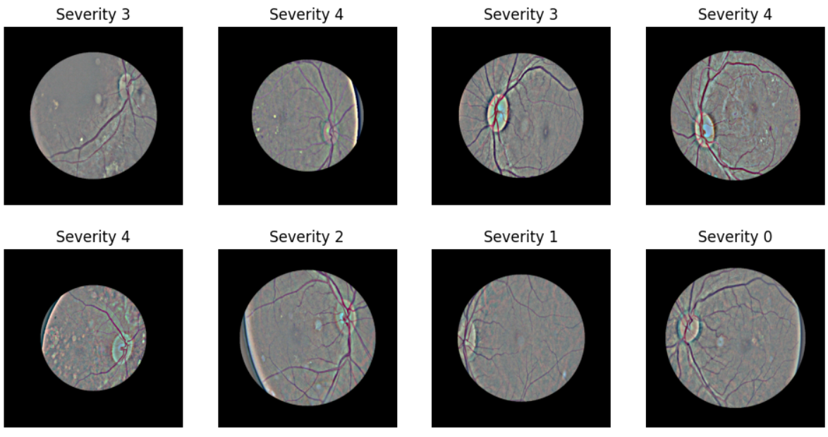
Ben-graham’s preprocessing result:

Slide 82
Weak-Learner: 1. InceptionV3
Learning rate: 0.0001009348577 (hyper parameter tuning by optuna)
Optimizer: Adam Loss function: Categorical cross entropy
Reduce learning rate on plateau of validation loss by factor 0.2 and patience 3
Epochs:100
Validation accuracy: 0.4138
Validation Loss:1.8836
Evaluation:

Slide 83
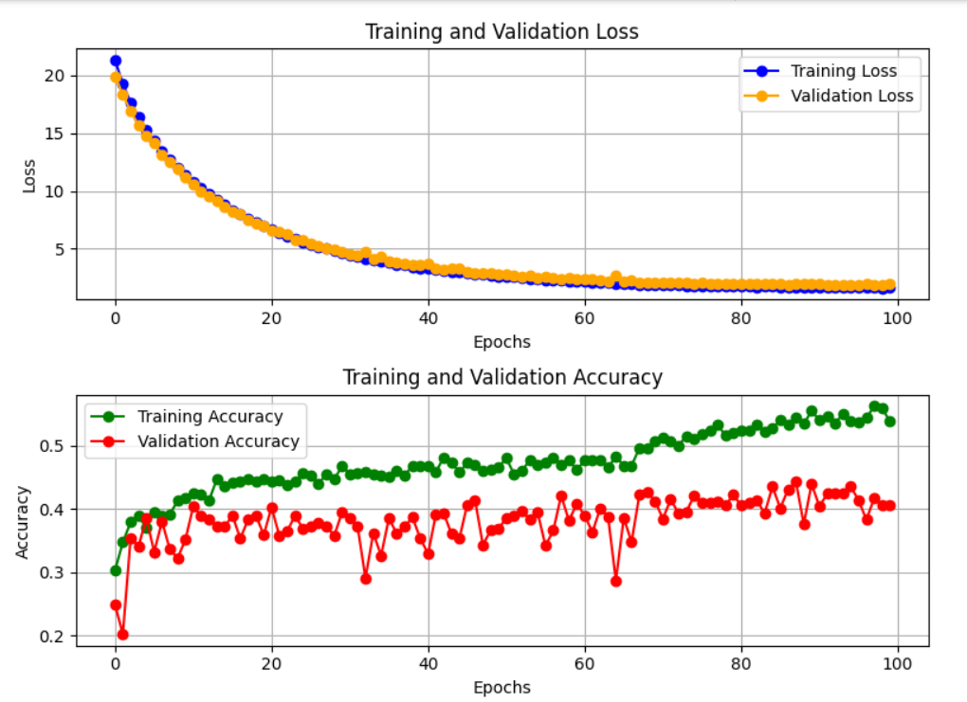

Slide 84
Weak-Learner: 2. ResNet50
Learning rate: 0.0001
Optimizer: Adam Loss function: Categorical cross entropy
Reduce learning rate on plateau of validation loss by factor 0.2 and patience 3
Epochs:100
Validation accuracy: 0.3136
Validation Loss: 3.2232
Evaluation:

Slide 85
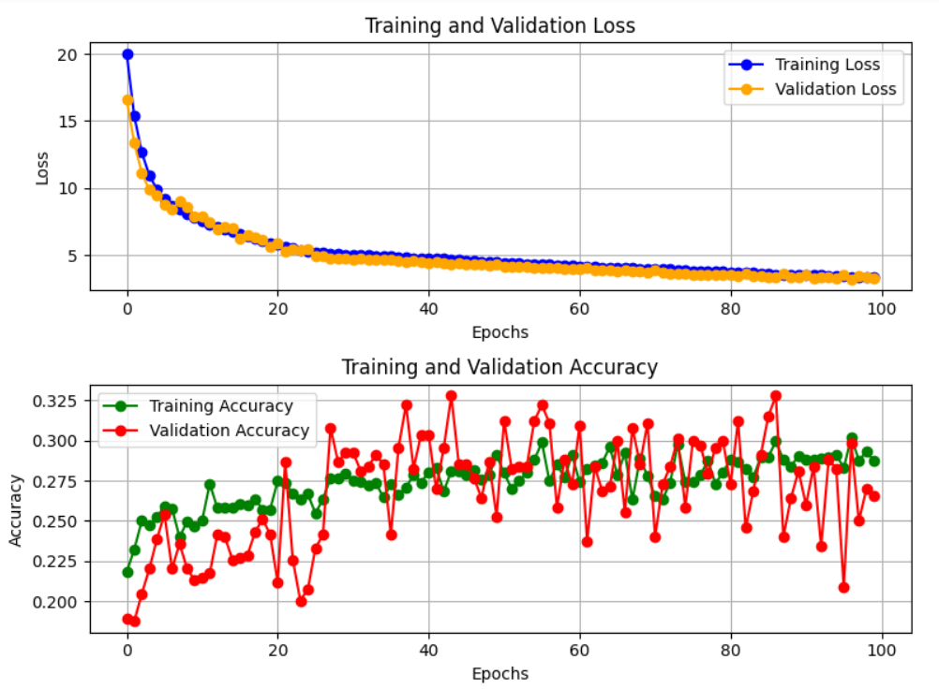

Slide 86
Weak-Learner: 3. EfficientNetB5
Learning rate: 0.0001
Optimizer: Adam Loss function: Categorical cross entropy
Reduce learning rate on plateau of validation loss by factor 0.2 and patience 3
Epochs:100
Validation accuracy: 0.2358
Validation Loss: 1.7712
Evaluation:

Slide 87
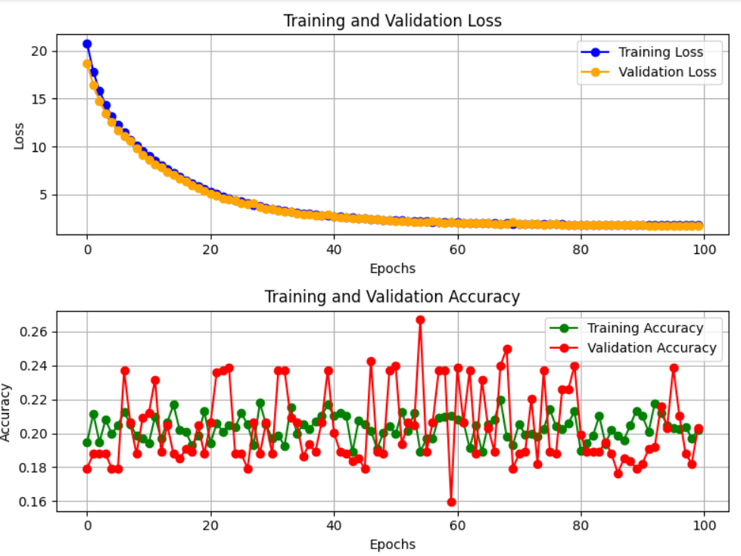

Slide 88
Weak-Learner: 4. DenseNet169
Learning rate: 0.0001
Optimizer: Adam Loss function: Categorical cross entropy
Reduce learning rate on plateau of validation loss by factor 0.2 and patience 3
Epochs:100
Validation accuracy: 0.4590
Validation Loss: 1.70
Evaluation:

Slide 89
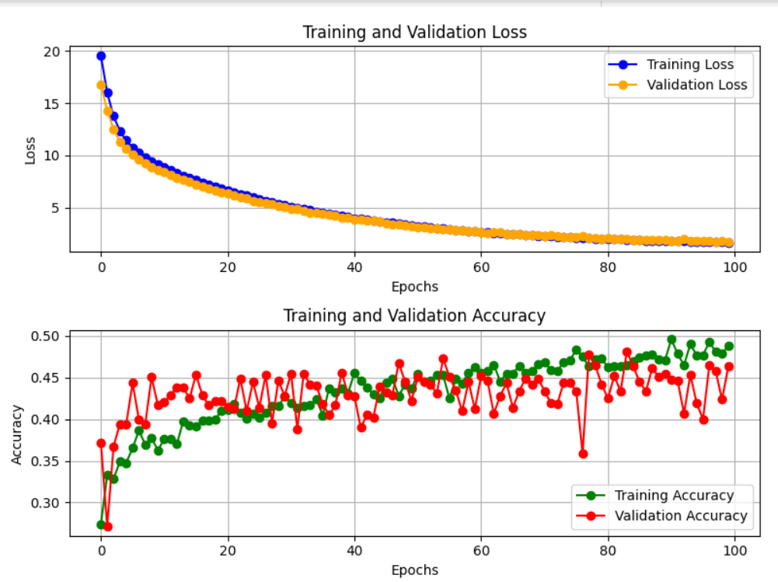

Slide 90
Ensemble Model
Epochs:100
Learning rate: 0.001
Batch size=16
Evaluation: Validation accuracy: 0.4378
Validation Loss: 2.50

Slide 91
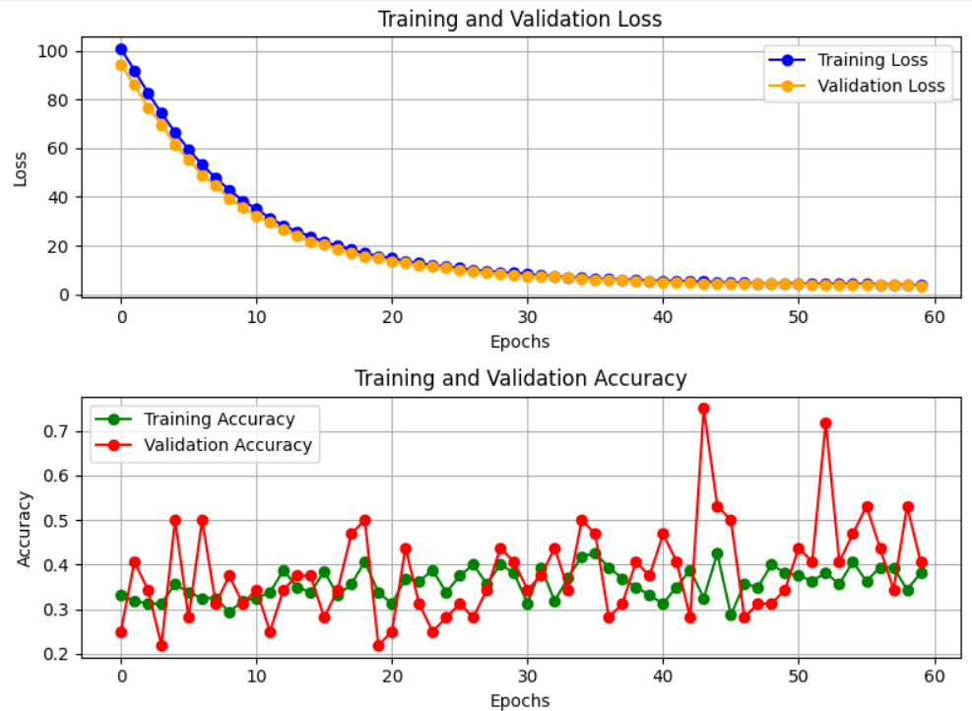
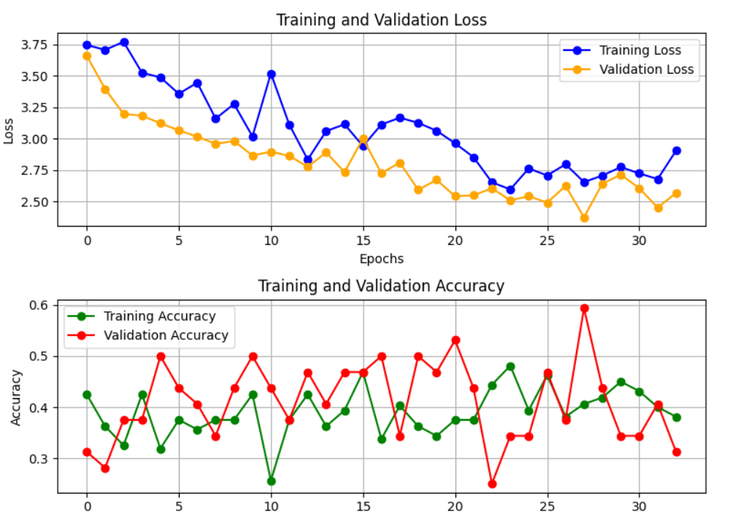

Slide 92
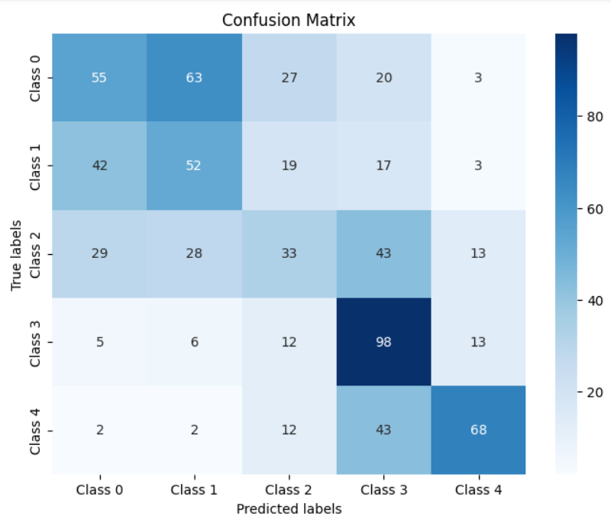
Evaluation of Ensemble model:
Precision: 0.43
Recall: 0.43
F1 score: 0.42
Accuracy: 0.43

Slide 93
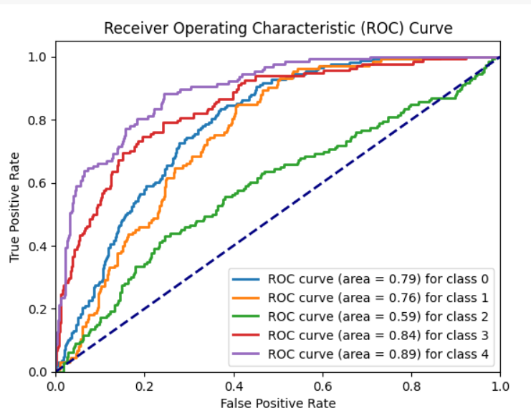

Slide 94
InceptionV3 Score for Preprocessing with Modified approach:
Image size=(224,224)
Evaluation:
Validation accuracy: 0.4265
Validation loss: 1.87

Slide 95
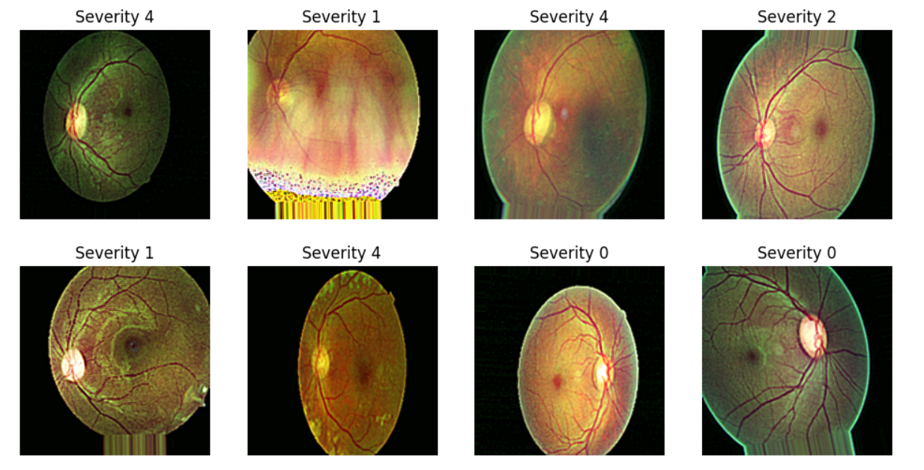

Slide 96
Cut-Mix augmentation + ben graham’s preprocessing +InceptionV3
Sampled data: 8408
After augmentation: 4000
Each class: 800
Image size=(224,224)
Batch size= 32

Slide 97
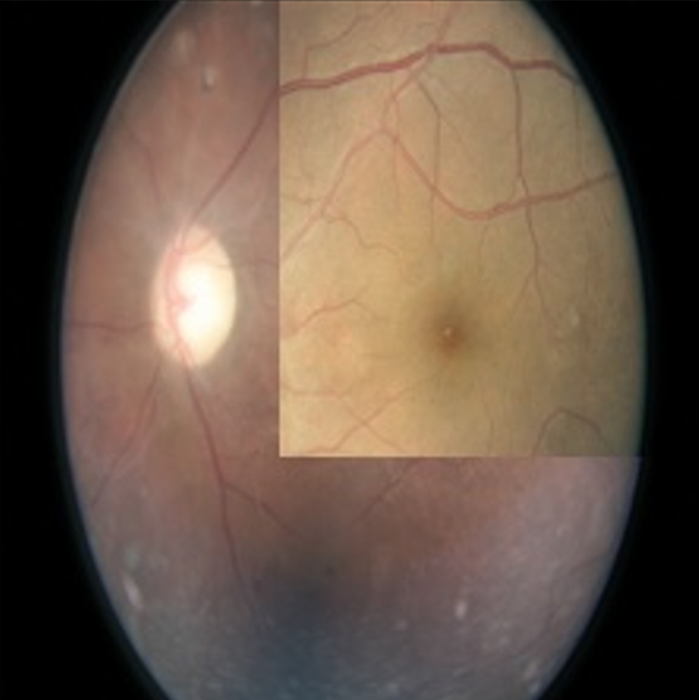
Cut-mix augmentation:
Additional images in class 1, class 3, class 4:
Class 1: 212
Class 3: 579
Class 4: 634
Sample :

Slide 98
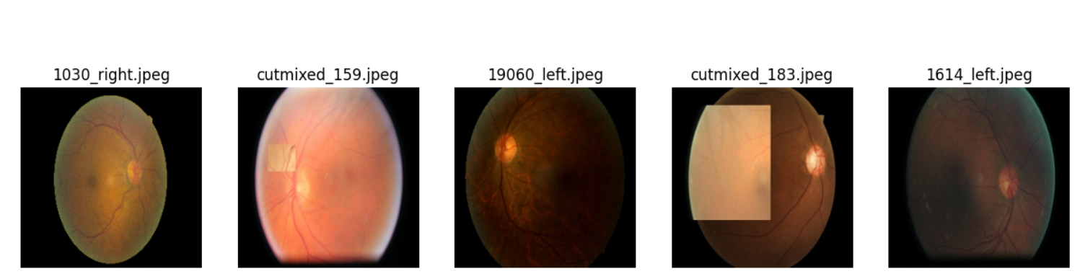
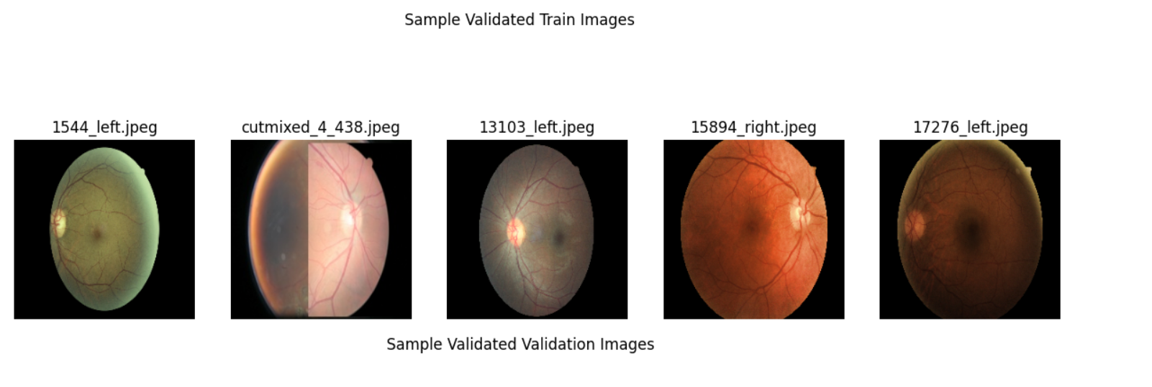
Training set: 3200
Validation set: 800
Sample validated images:

Slide 99
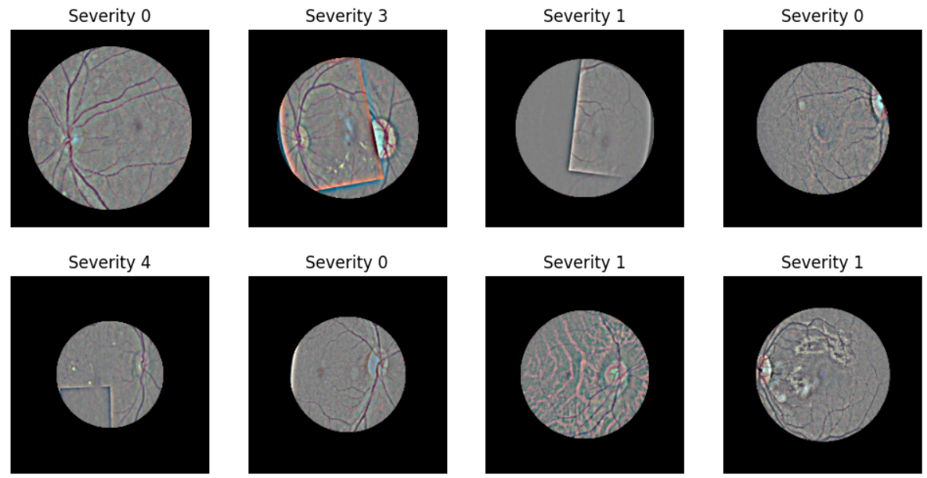
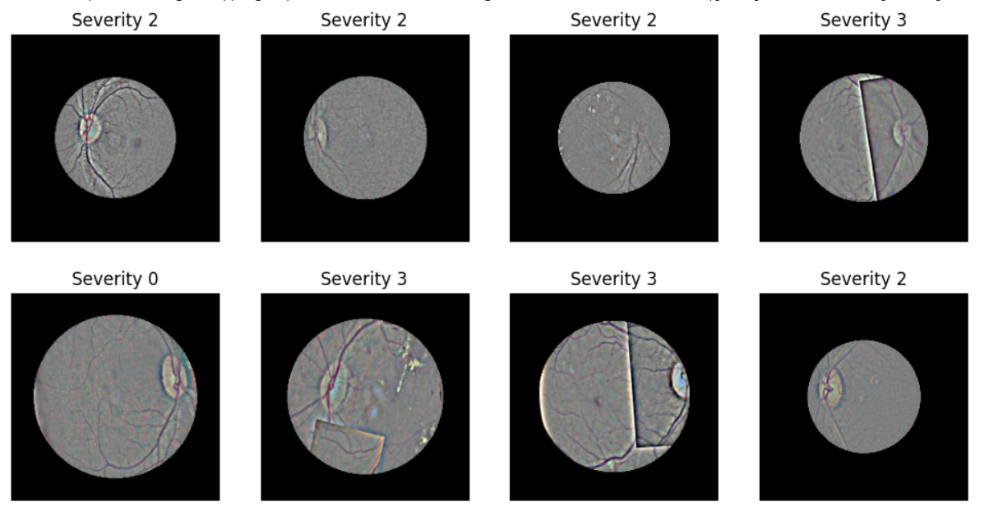
Cut mix + Ben graham’s preprocessing:

Slide 100
InceptionV3 score:
Validation accuracy: 0.5487
Validation loss: 1.58
Over all Evaluation:
Precision: 0.57
Recall: 0.57
F1 score: 0.57
Accuracy: 0.57

Slide 101
